Slide 1

IBM HR Analytics
Employee Attrition & Performance Deep Dive
INSIGHTS FOR STRATEGIC LEADERSHIP

Slide 2



EXECUTIVE SUMMARY
Our analysis of the IBM HR dataset reveals critical vulnerabilities in the 0-2 year tenure band and among overtime-heavy roles. Attrition is significantly front-loaded and heavily influenced by compensation progression and commute distance.
Primary Objective: Identify high-risk segments and deploy targeted retention interventions to safeguard organizational stability and reduce attrition costs.

Slide 3


PERFORMANCE METRICS
29.82%
50.63%
5.2y
7.4y
EARLY-TENURE ATTRITION
LOW HIKE IMPACT RATE
AVG STAY (LEFT)
AVG STAY (ACTIVE)
"Attrition is 5x more likely among new hires than those with 10+ years of tenure."

Slide 4
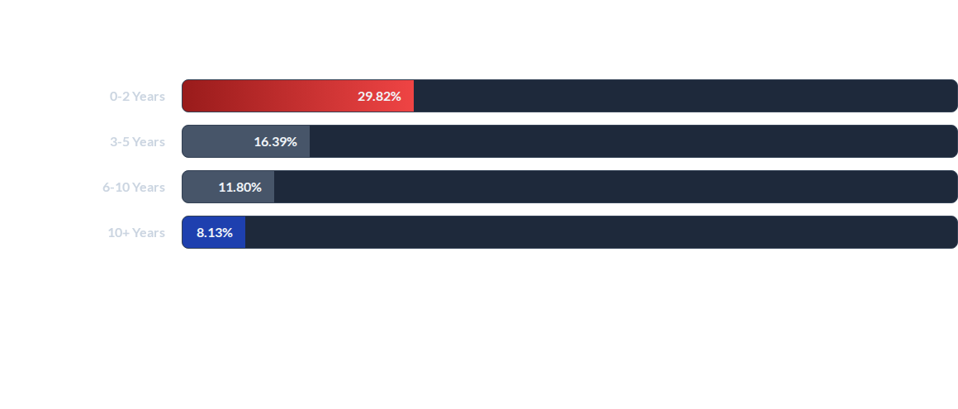
TENURE VULNERABILITY
Insight: The 'Honeymoon' period is critical. Attrition rates plummet by 73% once an employee crosses the 10-year threshold.

Slide 5

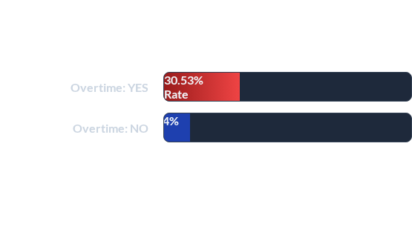

THE OVERTIME FACTOR
3x Higher Exit Risk
Employees working overtime are significantly more likely to leave the organization compared to their peers.
*Total sample: 416 Overtime workers vs 1054 non-Overtime workers.

Slide 6


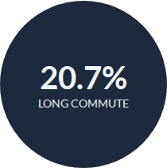


COMMUTE & PROXIMITY
Long (>15 mi): 20.67% Attrition
Mid (7-15 mi): 17.49% Attrition
Short (<7 mi): 13.55% Attrition

Slide 7


INCOME SENSITIVITY
81%
Concentrated in Low-Income
Attrition is overwhelmingly clustered among lower earning employees. This reinforces compensation competitiveness as the most critical pillar for retention.

Slide 8
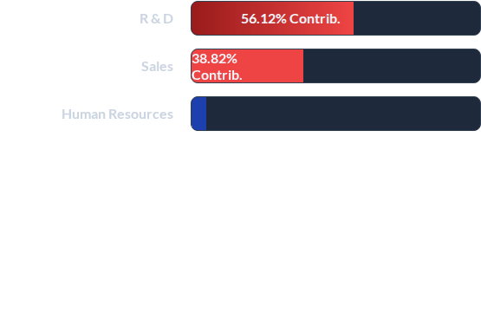



DEPARTMENTAL VULNERABILITIES
The R&D Crisis
Despite Research & Development having a moderate headcount attrition rate (13.84%), its scale makes it the source of over half of all exits.

Slide 9

JOB ROLE RISK MATRIX
Job Role | 0-2 Years | 3-5 Years | 6-10 Years | 10+ Years
Laboratory Technician | 14.77% | 4.64% | 6.33% | 0.42%
Sales Executive | 6.33% | 3.38% | 10.13% | 4.22%
Research Scientist | 8.44% | 2.53% | 8.44% | 0.42%
Sales Representative | 8.86% | 3.80% | 1.27% | 0.00%
Human Resources | 2.53% | 1.27% | 0.84% | 0.42%
Manager / Director Roles | < 1% | < 1% | < 2.5% | < 1%
*Highlighted percentages indicate peak attrition bands for high-churn roles.

Slide 10
RETENTION ROAD MAP
Overtime Audit: Re-evaluate staffing levels in R&D and Sales. Mitigating the 30% OT attrition risk is the most immediate cost-saving lever.
Honeymoon Engagement: Implement specialized '90-day checkpoints' and mentorship for employees in the 0-2 year bracket.
Compensation Calibration: Review salary benchmarks for low-income brackets. Closing pay gaps is essential for the 81% attrition segment.
Commute Flexibility: Introduce hybrid-work or commute-support for employees residing >15 miles from the workplace.

Slide 11
Questions?
Empowering HR Decisions through Analytics
IBM HR Analytics Dashboard Report
Contact: HR.Analytics.Team@corporate.com

Slide 12




IMAGE SOURCES
https://images.splitshire.com/full/The-Office-Building-Glowing-Blue-at-Night_BMndD.png
Source: www.splitshire.com
https://static.vecteezy.com/system/resources/thumbnails/047/561/041/small_2x/stressed-and-tired-asian-woman-office-worker-working-at-her-desk-in-the-dark-office-at-night-asian-business-woman-working-overtime-in-lamplight-free-video.jpg
Source: www.vecteezy.com
https://media.istockphoto.com/id/1437979369/photo/drone-shot-of-traffic-during-golden-hour-in-los-angeles-california.jpg?s=612x612&w=is&k=20&c=RU-Wljzag5jqziLZR9zNUMZ82qU4nm4sdVYMFX81r0o=
Source: www.istockphoto.com
https://d3njjcbhbojbot.cloudfront.net/api/utilities/v1/imageproxy/https://images.ctfassets.net/wp1lcwdav1p1/1gW7NrZHtfRAYdoIt0x5lC/c7bd22d7ac238c960d3f7b0dfeec4dce/GettyImages-1171660718.jpg?w=1500&h=680&q=60&fit=fill&f=faces&fm=jpg&fl=progressive&auto=format%2Ccompress&dpr=1&w=1000
Source: www.coursera.org

